Slide 1
Energy Efficient Video Player for Android
Under the guidance of Mrs. Gowri Patil
BY :
Abdul Gaffar (1604-15-733-115)
Rizwan (1604-15-733-)
(1604-15-733-)

Slide 2
Introduction
Dynamic voltage and frequency scaling (DVFS) can be used to extend battery life.
Multimedia applications are typically associated with higher computing complexity and thus consume more power.
The project is a video player for android which utilizes DVFS.

Slide 3
Scope of the project
This project is mainly developed to reduce the consumption of battery power.
The video player uses DVFS technique to restrict battery consumption
This is mainly associated with CPU usage
Intel based processors will give accurate results otherwise the result may vary processor to processor.

Slide 4
Existing system: MX player
This is the most widely used video player for android.
Of all the nifty features it packs like slide based volume and scrubbing controls it is a battery hogger.
Limited battery power in mobile devices poses a limitation to usage of this product
A design issue of this video players is energy consumption.

Slide 5
Proposed System

Slide 6
Modules
Module-1: user interface
In this module a welcome screen is first shown with the name of the application and an option to continue then a user interface is provided to the user to interact and select the required video from the list of video files he wishes to play. The list of files is shown from the local storage of the device
Module-2: DVFS
In this module, application sends the video file selected towards the proposed DVFS where a number of steps are performed on the file where the least CPU frequency required by the device to play the file while maintaining the QOS(Quality of Service) is calculated. The QOS constraints are not compromised for energy efficiency.
Module-3: Buffer
In this module, the file which was chosen by the user after having gone through the DVFS steps where the minimum CPU Frequency is calculated is placed into the buffer. A buffer is a temporary storage area, usually in RAM. This helps in maintaining efficiency.
Module-4: Player interface
In this module, the file placed in the buffer is fetched by the application and played. The user is provided with three options; play, pause and stop. User can use any of these three given options to perform actions on the selected file.

Slide 7
Complete Process

Slide 8
Architecture
DVFS Service

Slide 9
DVFS is based on MAR(Memory Access Rate) that calculates memory activity using the cache miss parameter on the PMU(Performance Monitoring Unit).
MAR is calculated between the no. of cache misses and the no. of total instructions and each counter can obtain the no. based on the PMU during run time.
MAR=Ncache_miss/Ninstruc_exec.
A correlation called the MAR-CSE describe the relationship to the target platform and is used to calculate critical speed.
MAR is retrieved from the hardware counters of the PMU.
This information is fed to the MAR-CSE to get the corresponding critical speed.
This critical speed is applied to the processor as the target frequency.

Slide 10
ALGORITHM
1: DVFS_enable is set to true.
2: for every Y milliseconds do
3: get the utilization since last check.
4: if DVFS enable is true then
5: get the MAR.
6: if MAR < efficient then
7: switch to the highest working freq.
8: else if efficient < MAR < not efficient then
9: calculate critical speed by MAR-CSE.
10: if utilization < 20% then
11: DVFS_enable is false.
12: end if
13: if utilization > 80% then
14: DVFS_enable is true.
15: end if
16: end for

Slide 11
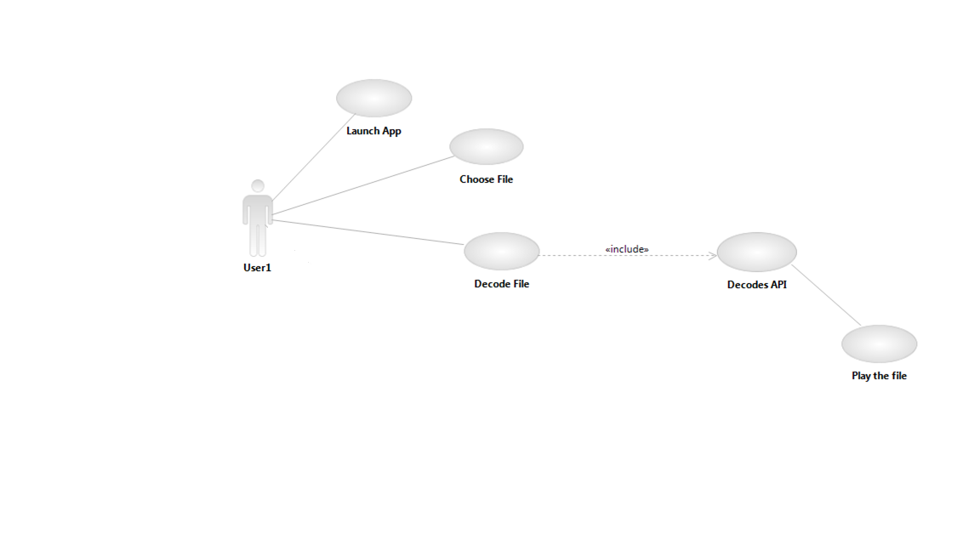
Use case diagram
DVFS
Player API

Slide 12
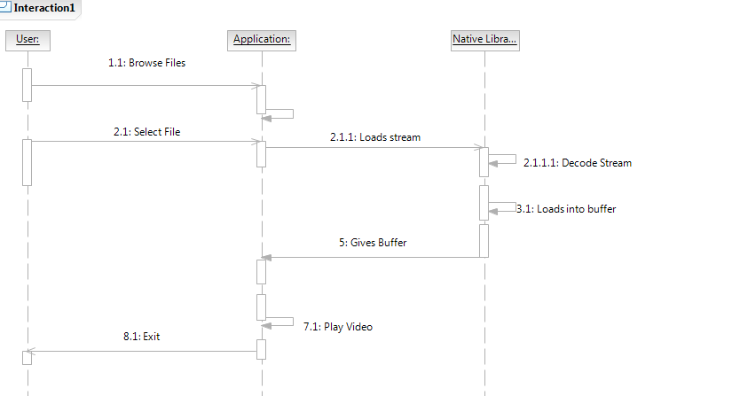
Sequence diagram
stream

Slide 13
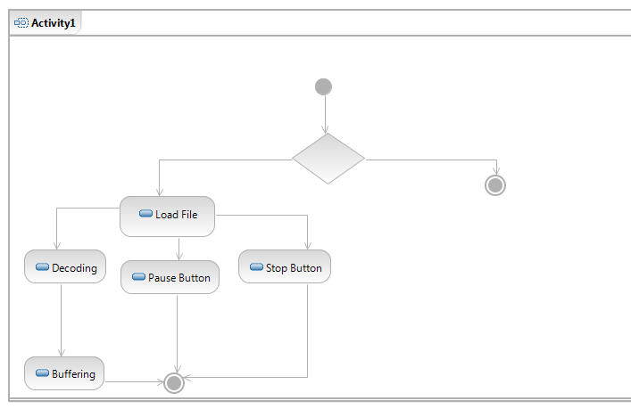
Activity diagram

Slide 14
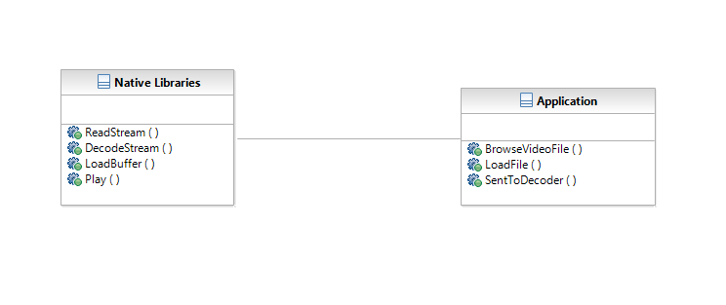
Class diagram

Slide 15
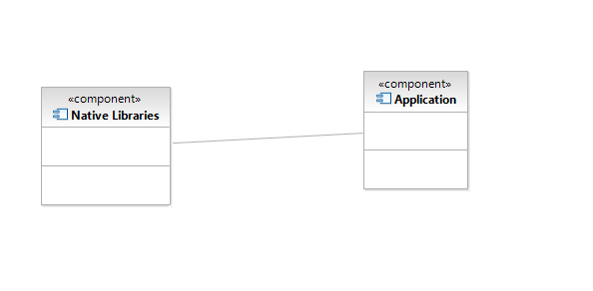
Component diagram

Slide 16
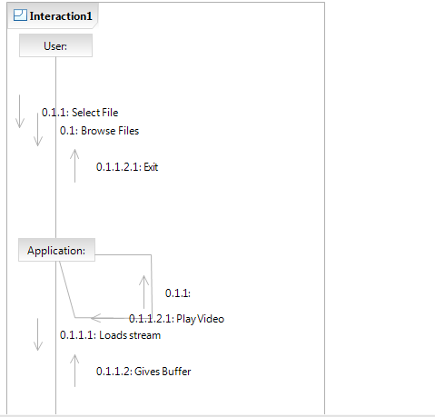
Collaboration diagram

Slide 17
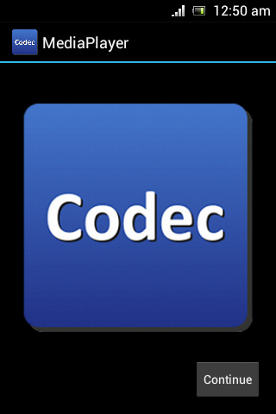
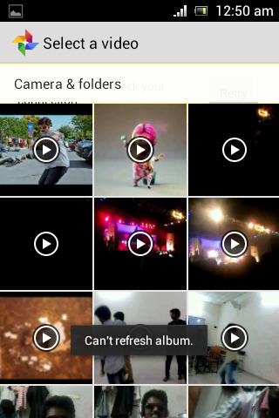
Screenshots

Slide 18
Media Player

Slide 19
Conclusion
The video player developed, in theory will reduce CPU usage
This in turn will reduce battery consumption

Slide 20
Future enhancements
Adding advanced features like:
Volume control
Brightnes control
Slide to scrub
Play back through cloud storage

Slide 21
References
The Unified Modeling Language Users guide
By Grady Brooch
Software Engineering, A practitioners approach
By Roger S Pressman
Software Project Management
By Walker Royce
Head First Series for Java
http://www.w3schools.com/webservices/default.asp
http://www.dreamincode.net/forums/topic/42301-beginners-guide-to-creating-simplemysql-tables/

